Slide 1
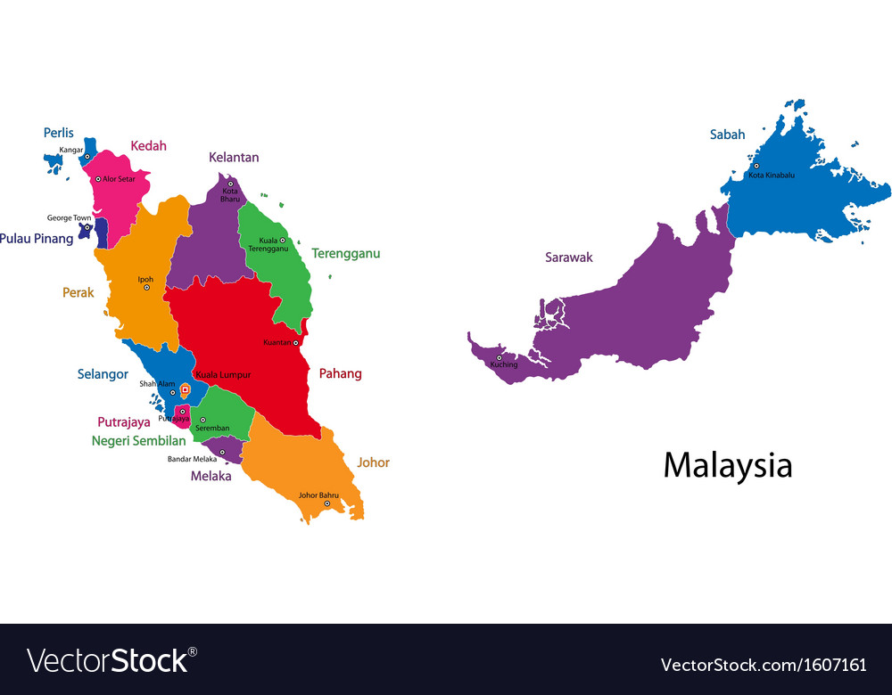
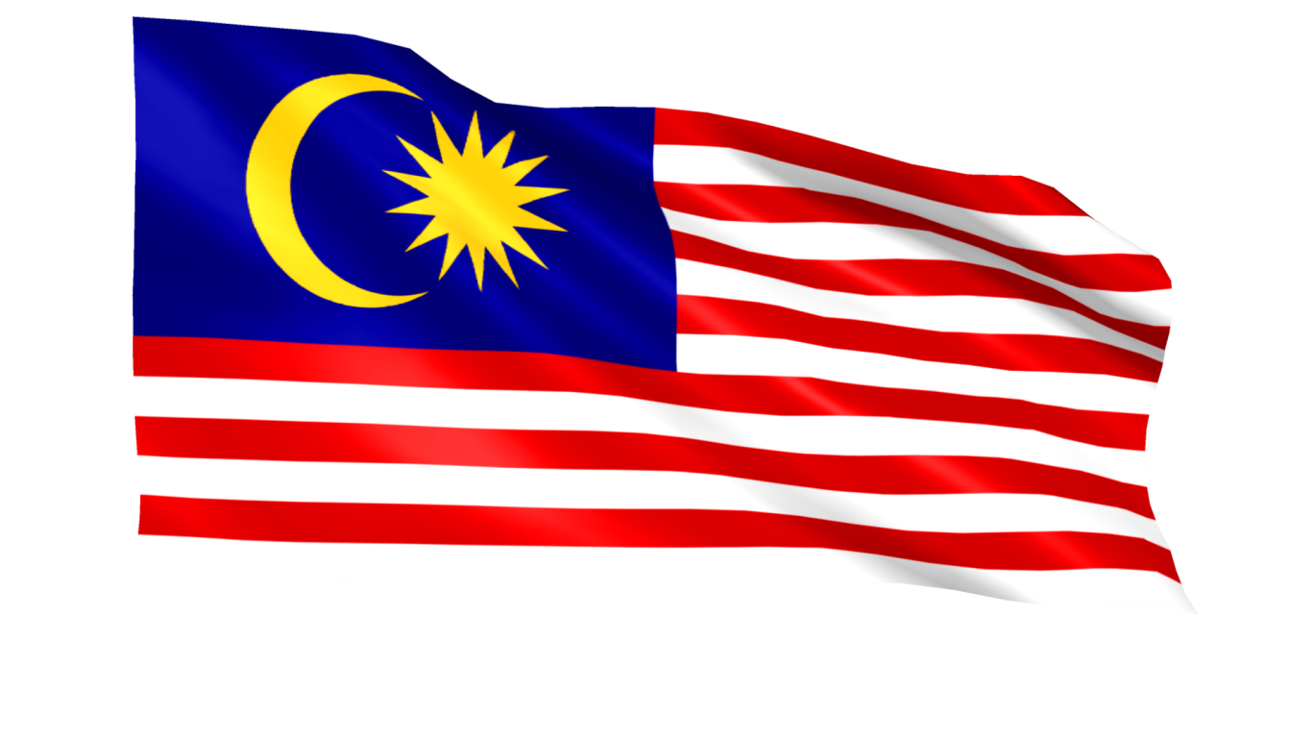

Slide 2
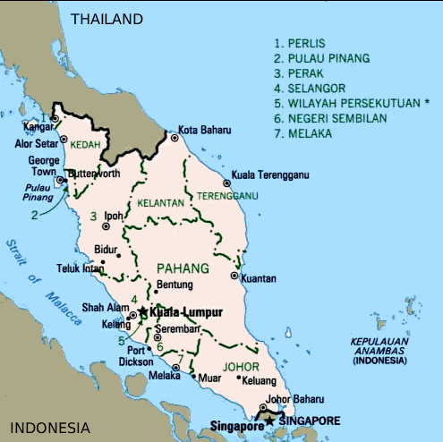
Geography
Peninsular Malaysia
Perlis
Kedah
Penang
Perak
Selangor
Negeri Sembilan
Malacca
Johor
Pahang
Terengganu
Kelantan

Slide 3
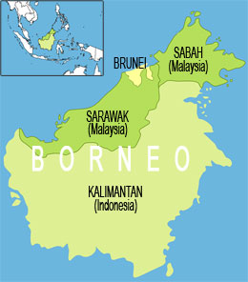
Malaysian Borneo

Slide 4
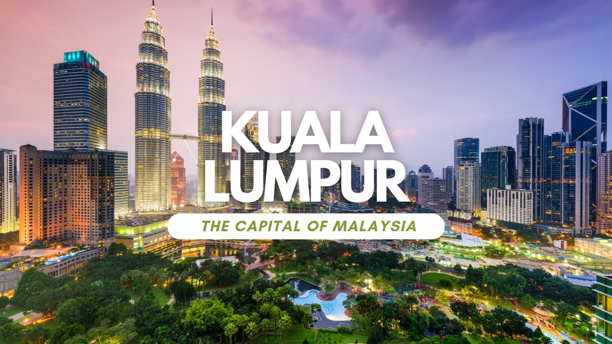
Capital

Slide 5
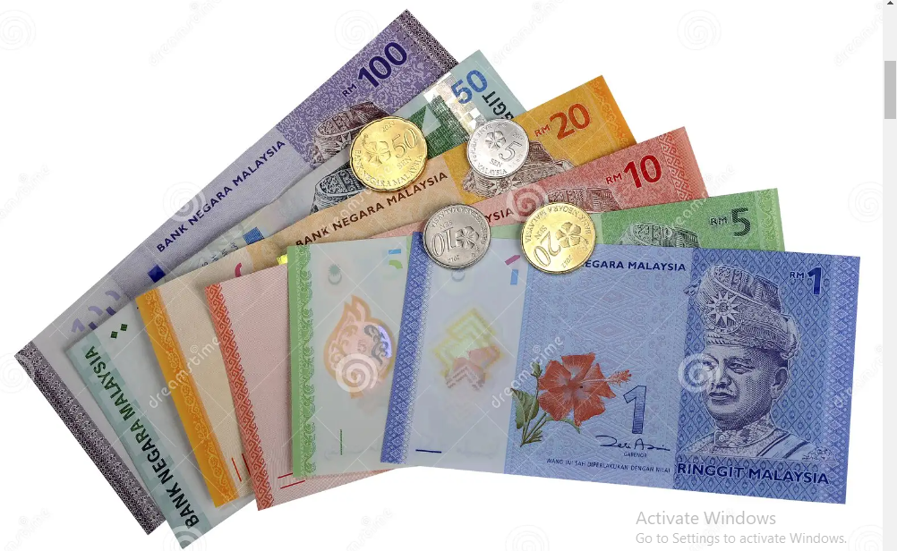
Currency of Malaysia

Slide 6
Language - Malayu
Common Phrases and translation:
Hello | Hallo
Welcome | Selamatdatang
Good bye | Selamatjalan/ selamattinggal
See you again | Jumpalagi
Yes | Ya
No | Tidak
Thank you | TerimaKasih
How are you? | Apakhabar?
I'm fine | Khabarbaik
Please | Sila
My name is..... | Namasayaialah…
Can you speak Bahasa Malaysia? | BolehcakapMlayu?
I don’t understand | Sayatidakfaham
Help | Tolong

Slide 7
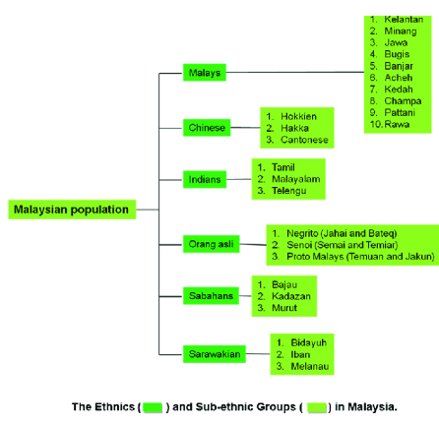
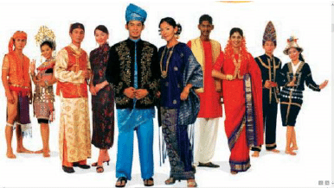
Ethnic Diversity

Slide 8
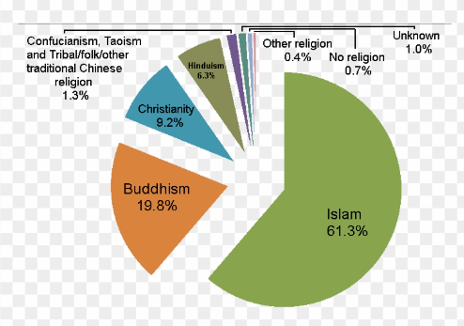
Religion

Slide 9
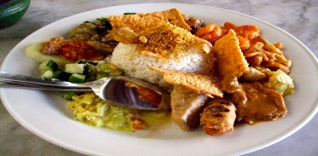
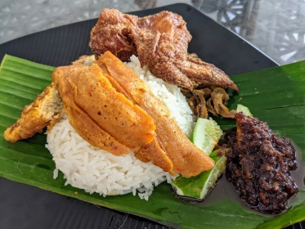
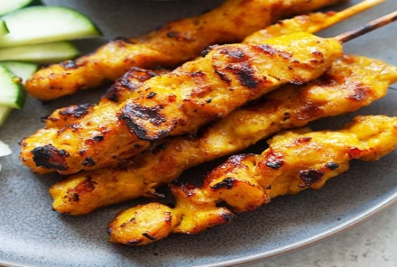
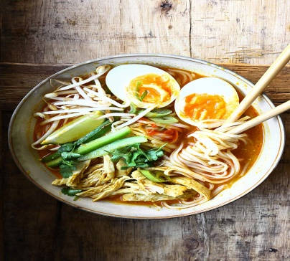
Cuisine
nasi campur
nasi lemak
Satay
laksa

Slide 10
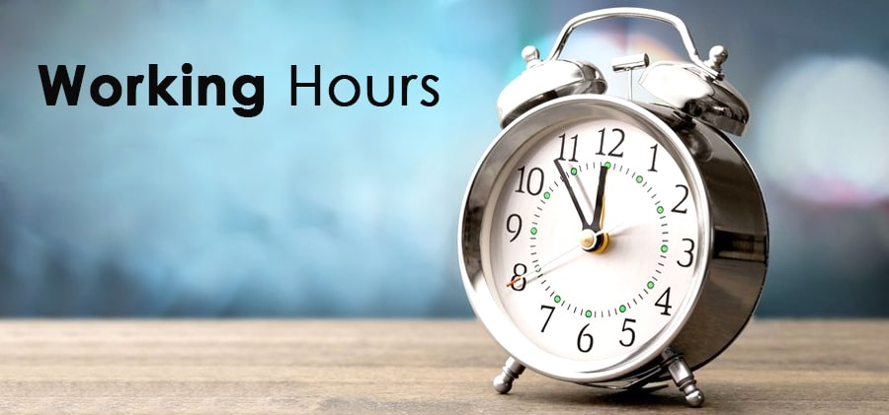
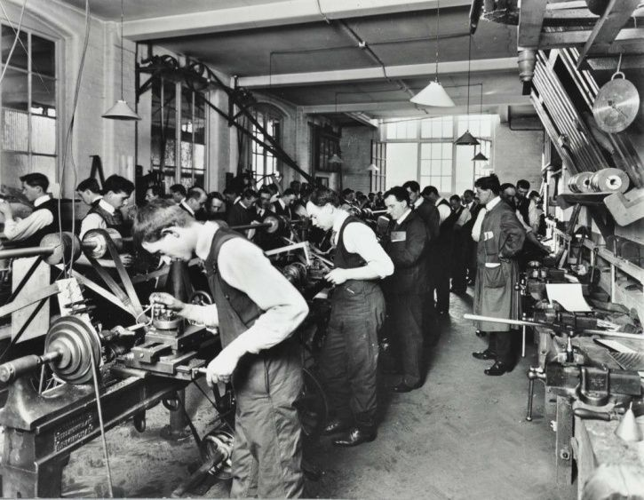
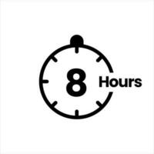

Slide 11
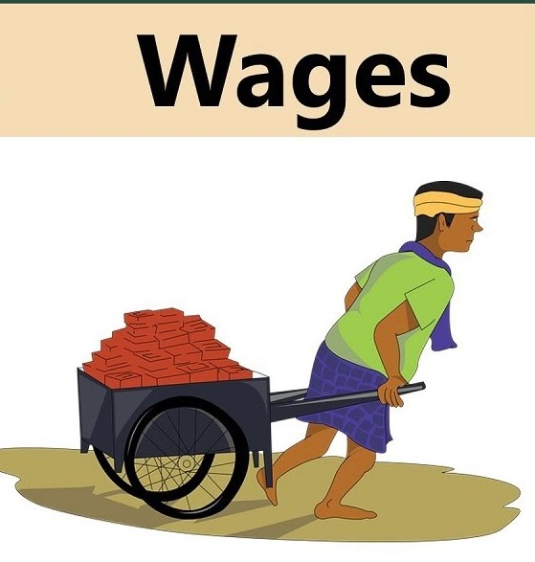
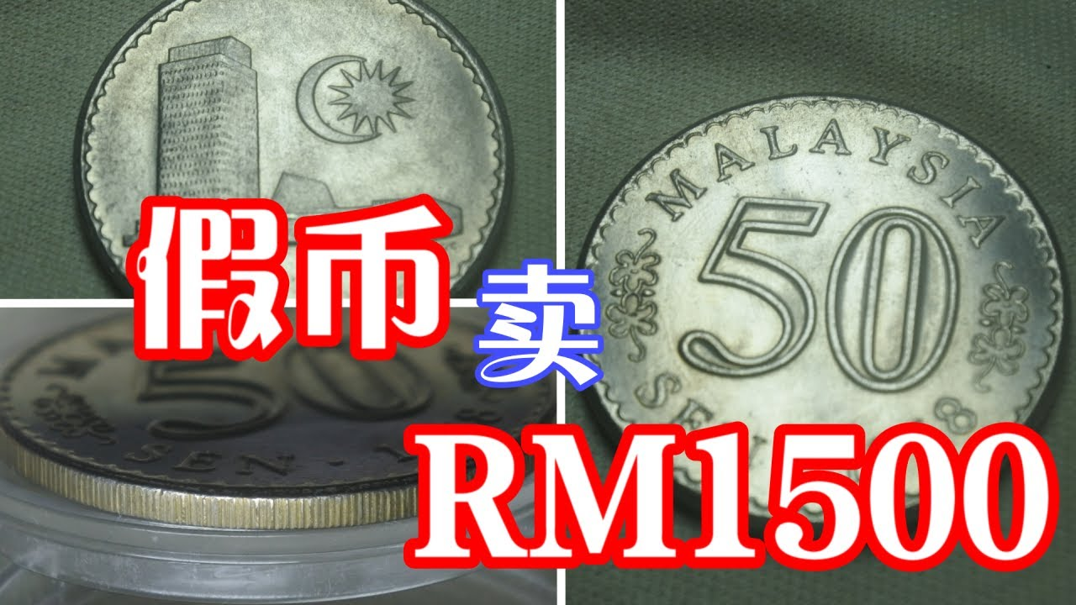
Basic Salary

Slide 12
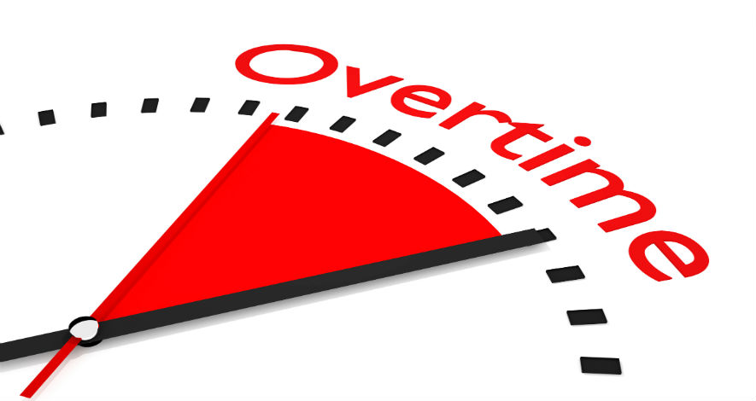
On Normal Days Salary * 1.5
On Sundays/rest days Salary * 2.0
On public holidays Salary * 3.0

Slide 13
1. The National Day 2. The Birthday of Yang di-Pertuan Agong 3. Birthday of ruler of the state 4. Labour day 5. Chinese New Year – 2 days 6. Hari Raya Puasa – 2 days 7. Malaysia Day – 1 day 8. Deepawali – 1 day 9. Christmas day - 1 day

Slide 14
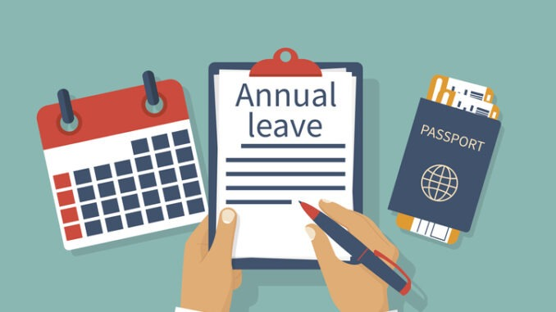
First 2 Years of Service – 8 days
2 to 5 Years of Service – 12 days
More than 5 years of service – 16 days

